Slide 1
Manet-A Research based project.
Namrata Khatwani
(17IT045)

Slide 2
What is MOBILE AD-HOC NETWORK?
A mobile ad hoc network (MANET) is a continuously self-configuring, self-organizing, infrastructure-less, network of mobile devices connected without wires. It is sometimes known as "on-the-fly" networks or "spontaneous networks".
Broadly defined, a mobile ad hoc network is a group of wireless nodes (which aren’t routers) that cooperatively form a network that operates without the support of any fixed infrastructure. MANETs usually have a routable networking environment on top of a Link Layer ad hoc network. MANETs consist of a peer-to-peer, self-forming, self-healing network. MANETs circa 2000–2015 typically communicate at radio frequencies (30 MHz – 5 GHz).

Slide 3

What does MANET solve ?
Such networks have been proposed for a wide variety of goals: data collection in sensor arrays; providing a communication infrastructure in hostile or disaster-stricken areas.
Proposal of this kind of idea, involves being able to communicate in an area, which has no network facilities, or a remote location, in case of any natural disasters, for communication of a short and long range provided, that some facilities like file transfer and web access is allowed during communication.

Slide 4
Challenges
Basic network services such as name resolution, file system management, and mail and Web services are centrally administered. In an ad hoc environment these services cannot be centralized, because the network population and topology are not known in advance.
In the fixed network, security depends on encryption keys, certificates, and authorization information stored in trusted repositories, both local and global. Other security mechanisms depend on firewalls, which block traffic from outside an organization’s administrative domain.

Slide 5
Once it is possible to identify network participants, users must adapt authorization and access control policies in response to the changing network population. Firewall-based security is not applicable in this context because there is no administrative domain for which to distinguish inside and outside.
Also, Implementation.

Slide 6
Why not use OSPF or RIP instead?
Limited nodes allowed, also nodes are not routers.
Higher loss rate
Frequent topology changes
Addressing is difficult, as there is no hierarchy.

Slide 7
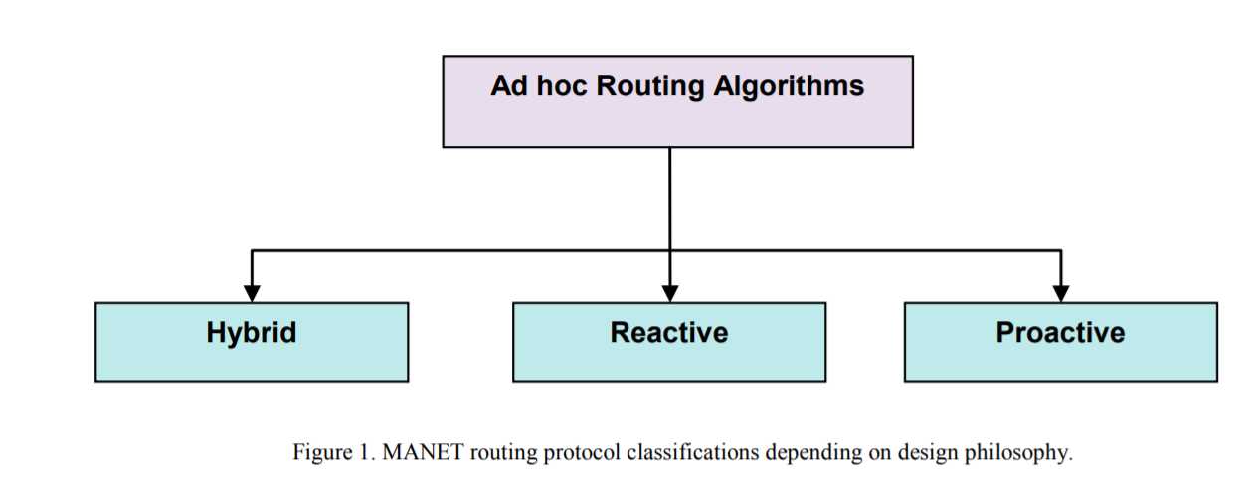
Algorithms related to Ad-Hoc Network.

Slide 8
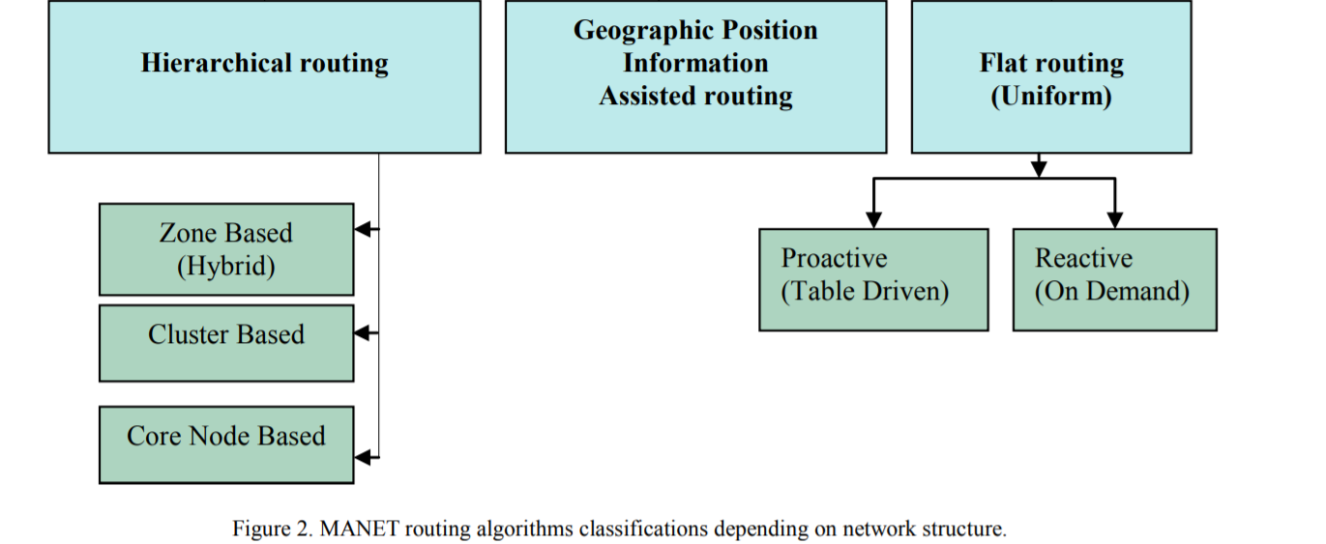
Network structure Algorithms

Slide 9
Algorithms under MANET under Proactive
OLSR (OPTIMISED LINK STATE ROUTING) ProActive
AODV(AD-HOC ON DEMAND DISTANCE VECTOR) ReActive
DSR(DYNAMIC SOURCE ROUTING) ReActive

Slide 10
OLSR
OLSR (Optimized Link State Routing)
In OLSR, each node periodically constructs and maintains the set of neighbors that can be reached in 1-hop and 2-hops. Based on this, the dedicated MPR algorithm minimizes the number of active relays needed to cover all 2-hops neighbors. Such relays are called Multi-Point Relays (MPR). A node forwards a packet if and only if it has been elected as MPR by the sender node. In order to construct and maintain its routing tables, OLSR periodically transmit link state information over the MPR backbone. Upon convergence, an active route is created at each node to reach any destination node in the network.

Slide 11
AODV
AODV (Ad-hoc On-demand Distance Vector)
In AODV, when a source node has data traffic to send to a destination node, it first initiates a route discovery process. In this process, the source node broadcasts a Route Request(RREQ) packet. Neighbor nodes which do not know an active route for the requested destination node forward the packet to their neighbors until an active route is found or the maximum number of hops is reached. When an intermediate node knows an active route to the requested destination node, it sends a Route Reply (RREP) packet back to source node in unicast mode. Eventually, the source node receives the RREP packet and opens the route.

Slide 12
DSR
The Dynamic Source Routing Protocol is an on-demand reactive routing protocol.
In DSR a node maintains route cache which contains the source routes that it is aware of. The node updates records in the route cache when a new route is found. Route Discovery and Route Maintenance are the two main parts of DSR. When a node wants to send a packet as a source to a specific destination, it searches in its route cache in order to determine if it already contains a route to the destination. If it finds a route to the destination exists, then it uses this route to send the packet. But if the node does not have a route to the destination, then it initiates the route discovery process by broadcasting a route request packet. Each intermediate node checks if there is a route to the destination in its cache. If there is no route, it appends its address to the route record of the packet and forwards the packet to its neighbors. A route reply message is generated when the destination or an intermediate node that have current information about the destination receives the route request packet.

Slide 13
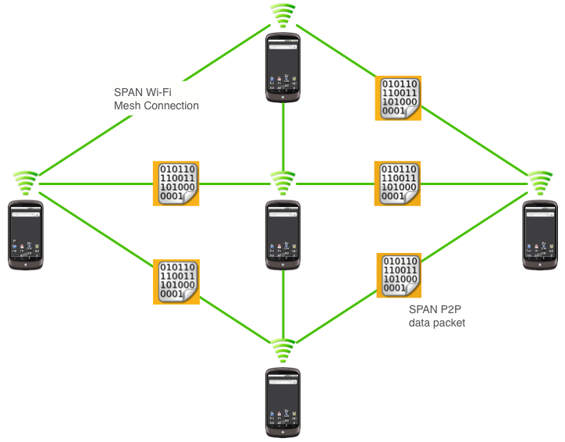
Pictorial representation

Slide 14
Drawbacks to solve.
Certificate Authority (CA) alternative
CA server may not be accessible
What if there’s no way to get the root certificate to validate signatures?
What if root certificate jeopardized?
Peers bump phones on the fly to establish a web of trust

Slide 15
Route data through trusted peers
Each peer signs data as it works its was through the mesh
Receiver (has to) validates each signature

Slide 16
Split-packet routing
Split each packet into two and send them over non-overlapping routes
Receiver reconstructs original packet, each half is useless without the other
Don’t request or push an unsigned public key over the air in plain text
Can MITM Diffie-Hellmen key exchange without proper authentication

